Slide 1
Albemarle County Equity Profile
UVA Equity Center Democratization of Data Initiative
Dr. Michele Claibourn
Director of Equitable Analysis
Mpc8t@virginia.edu
Sam Powers
Statistician, Data Visualization Practitioner sdp7xc@virginia.edu
http://virginiaequitycenter.org
Notes:
Text is Seravek font (Extra light to extra bold options, but main body text is Light, Titles are Bold. Subtitles medium bold)

Slide 2
Ways to evaluate quality of life and well-being in Albemarle County?
The American Human Development Index (AHDI) is a metric that assesses the distribution of well-being and equity along three axes: health, access to knowledge, and living standards.
Health is measured via…
Life Expectancy at birth
Access to Knowledge is measured via…
HS Degree or more
Bachelors Degree or more
Grad Professional Degree or more
School enrollment
Living Standards is measured via…
Median Personal Earnings
These measures can be aggregated and disaggregated, and viewed across geography or race/ethnicity to gain a better understanding of well-being in a community

Slide 3
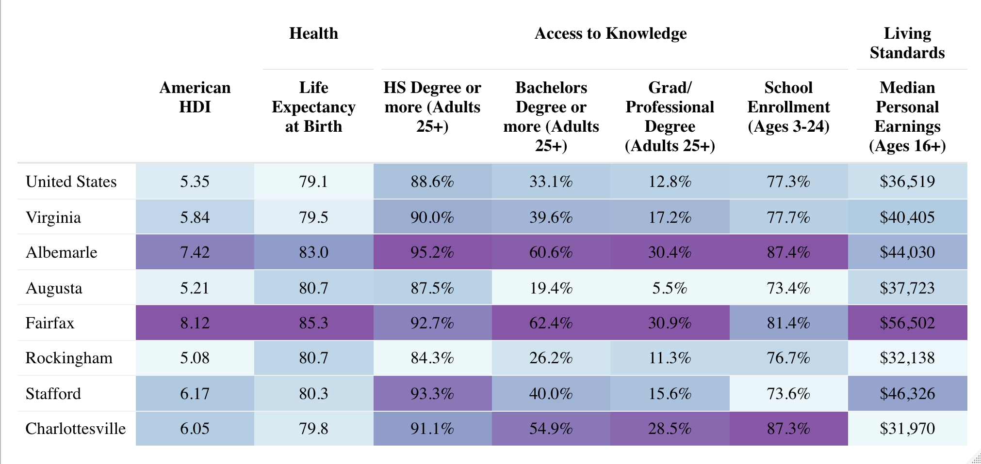
How do we know if Albemarle County is promoting well-being for all residents?
A comparison of American Human Development Index (AHDI) scores
American HDI
Health
Access to Knowledge
Living Standards

Slide 4
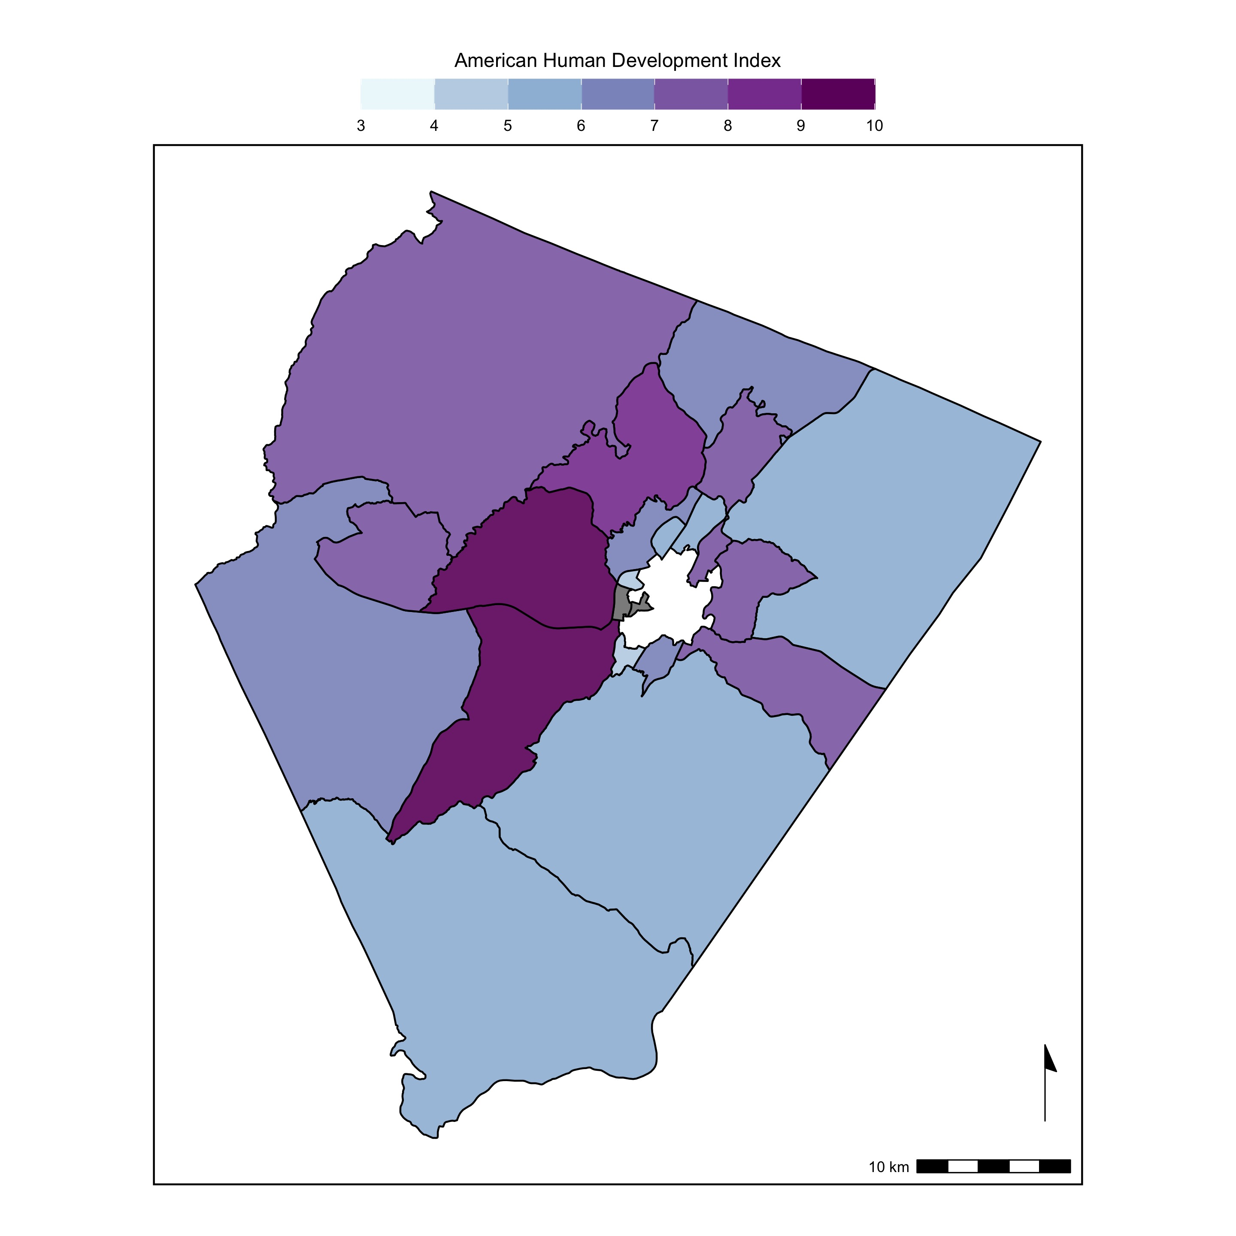
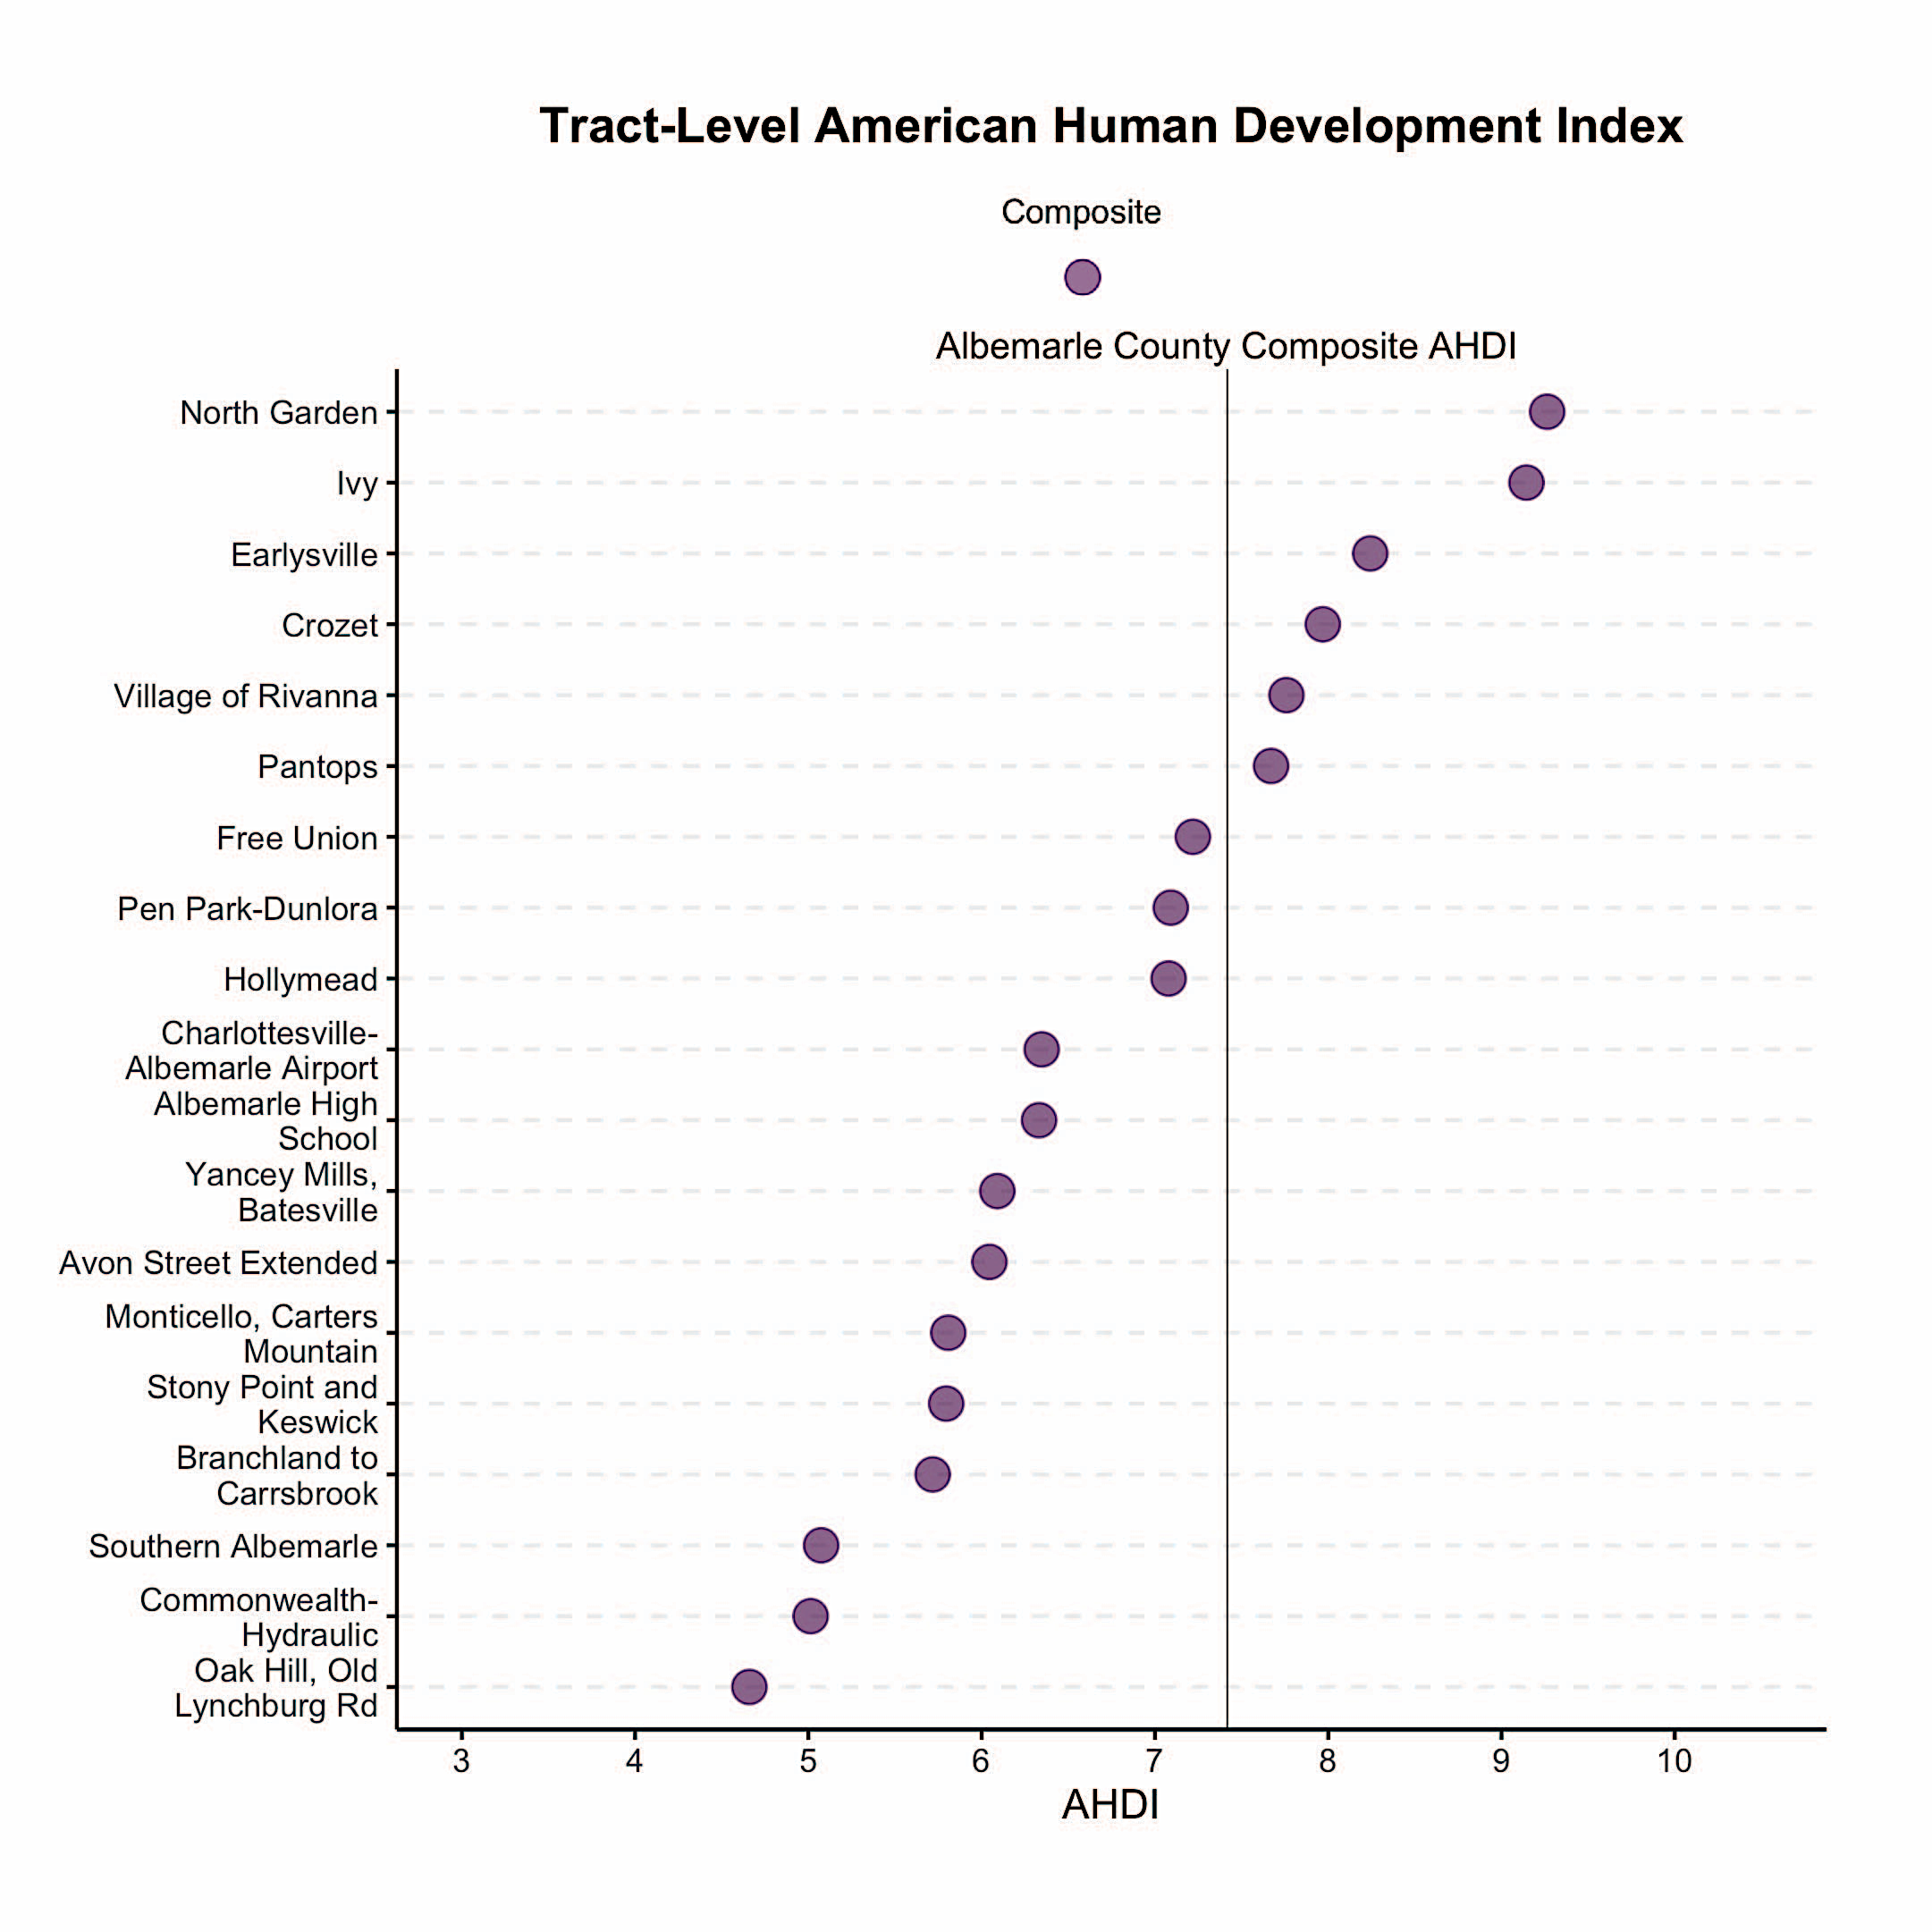
AHDI Comparison within Albemarle County
American HDI
Health
Access to Knowledge
Living Standards

Slide 5
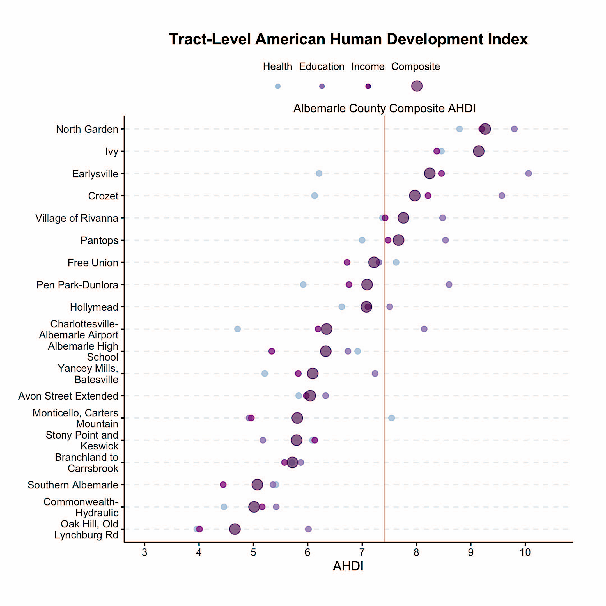
AHDI Comparison within Albemarle County (including sub-indices)
American HDI
Health
Access to Knowledge
Living Standards

Slide 6
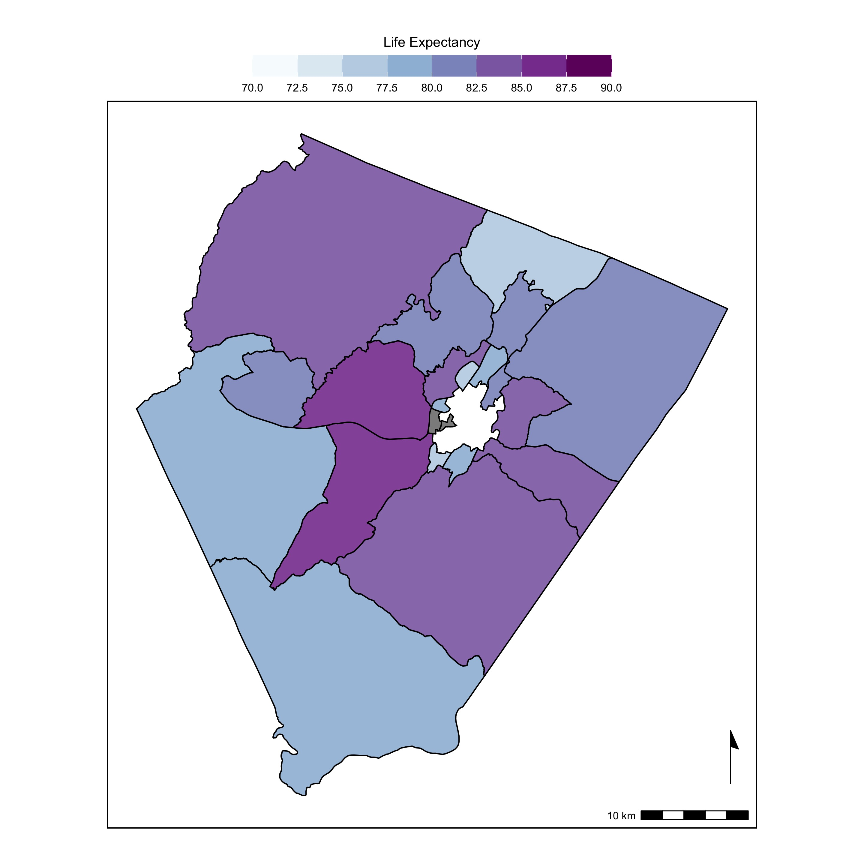
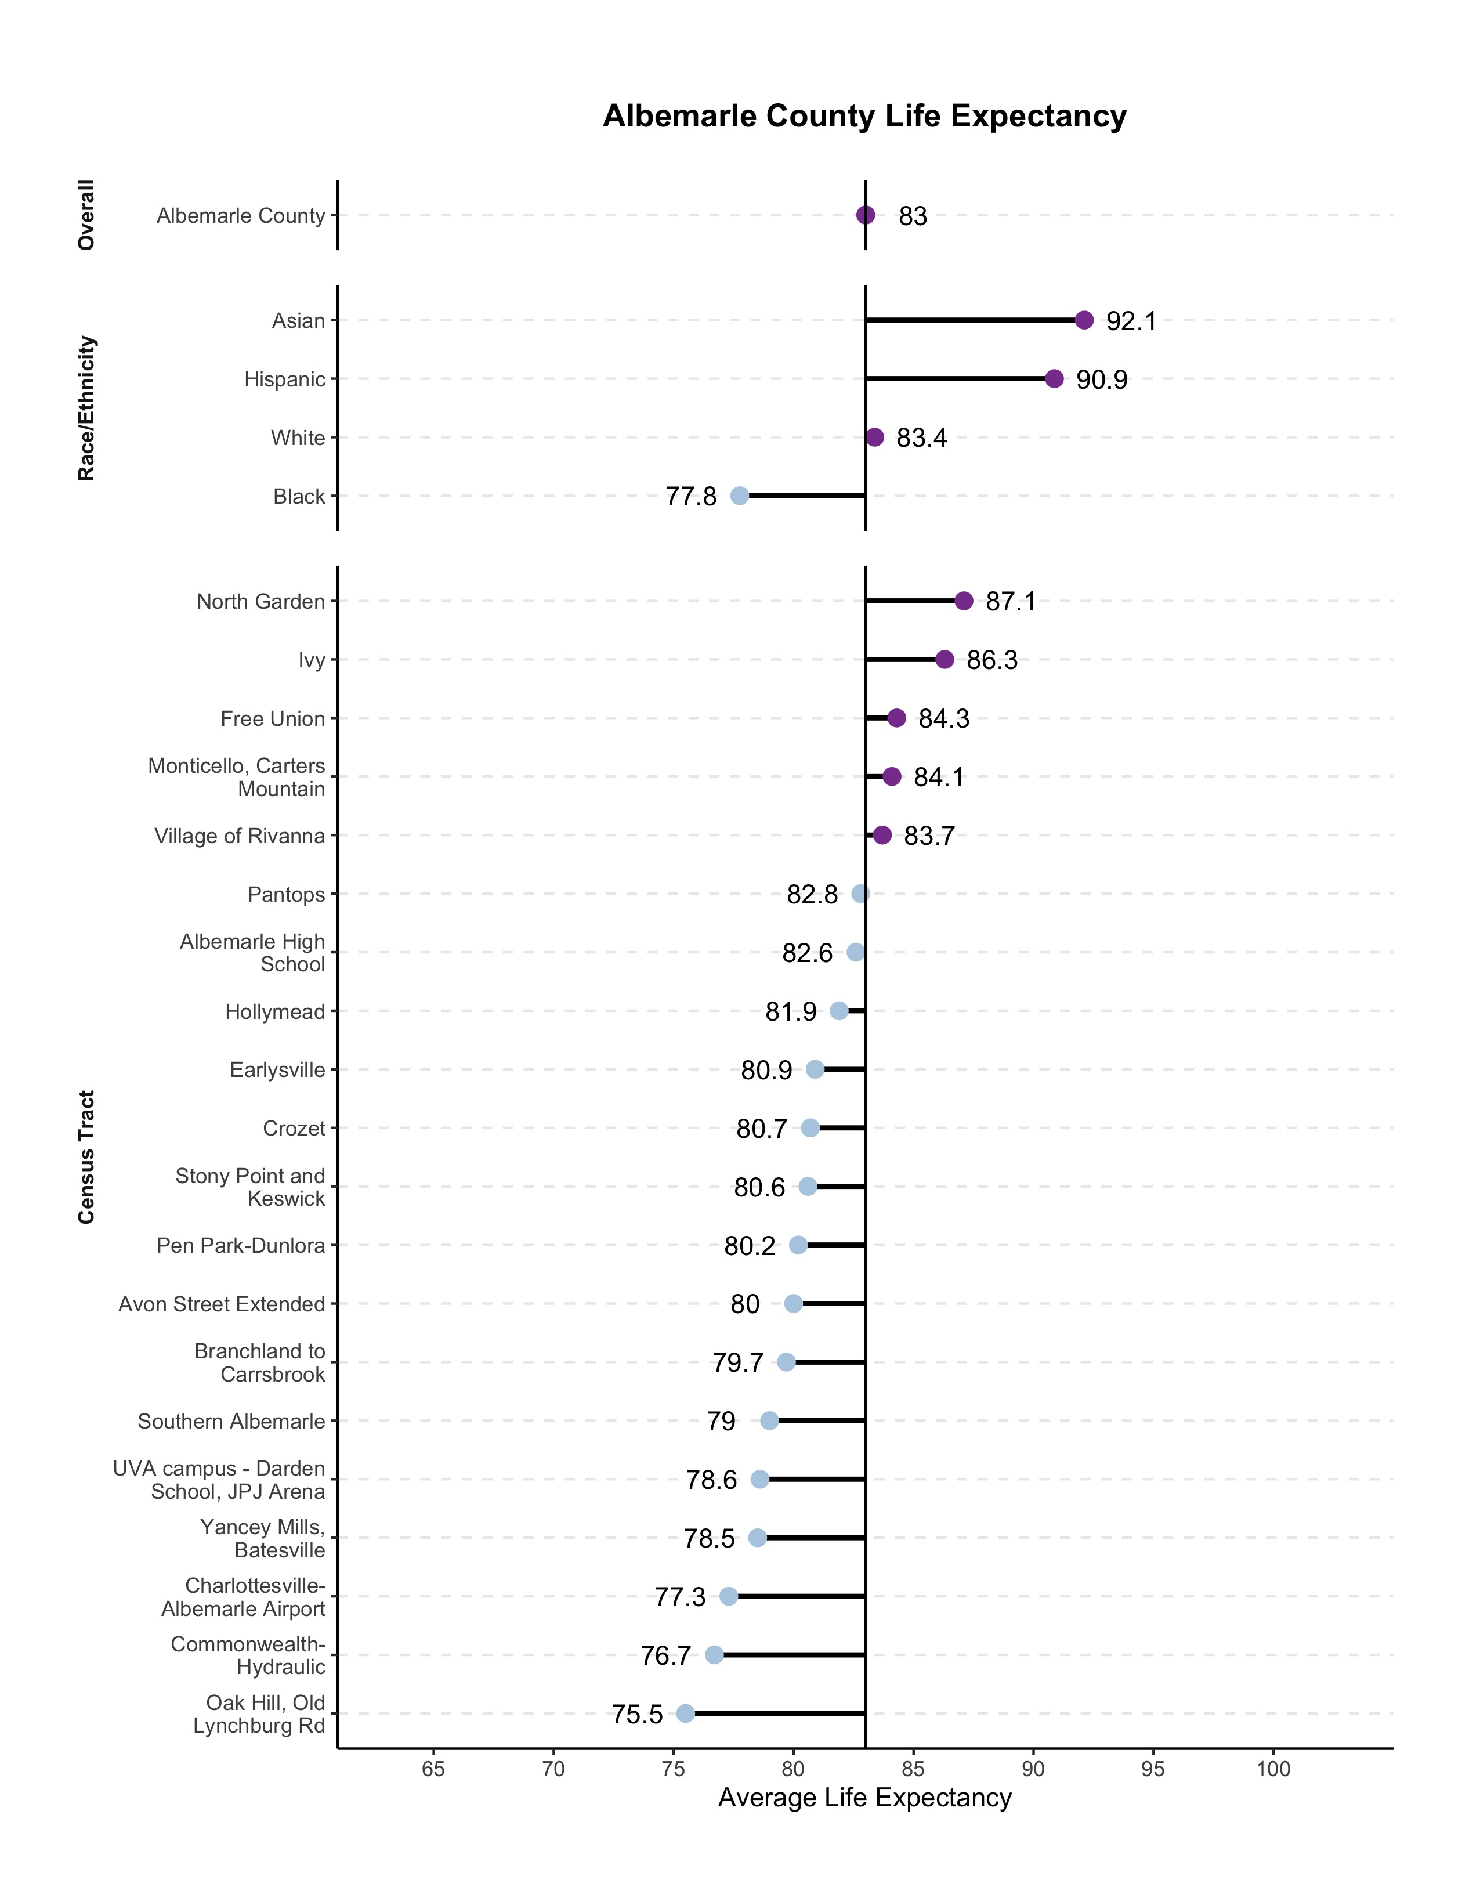
Albemarle County Life Expectancy Metrics
American HDI
Health
Access to Knowledge
Living Standards

Slide 7
Albemarle County Life Expectancy Metrics
American HDI
Health
Access to Knowledge
Living Standards

Slide 8
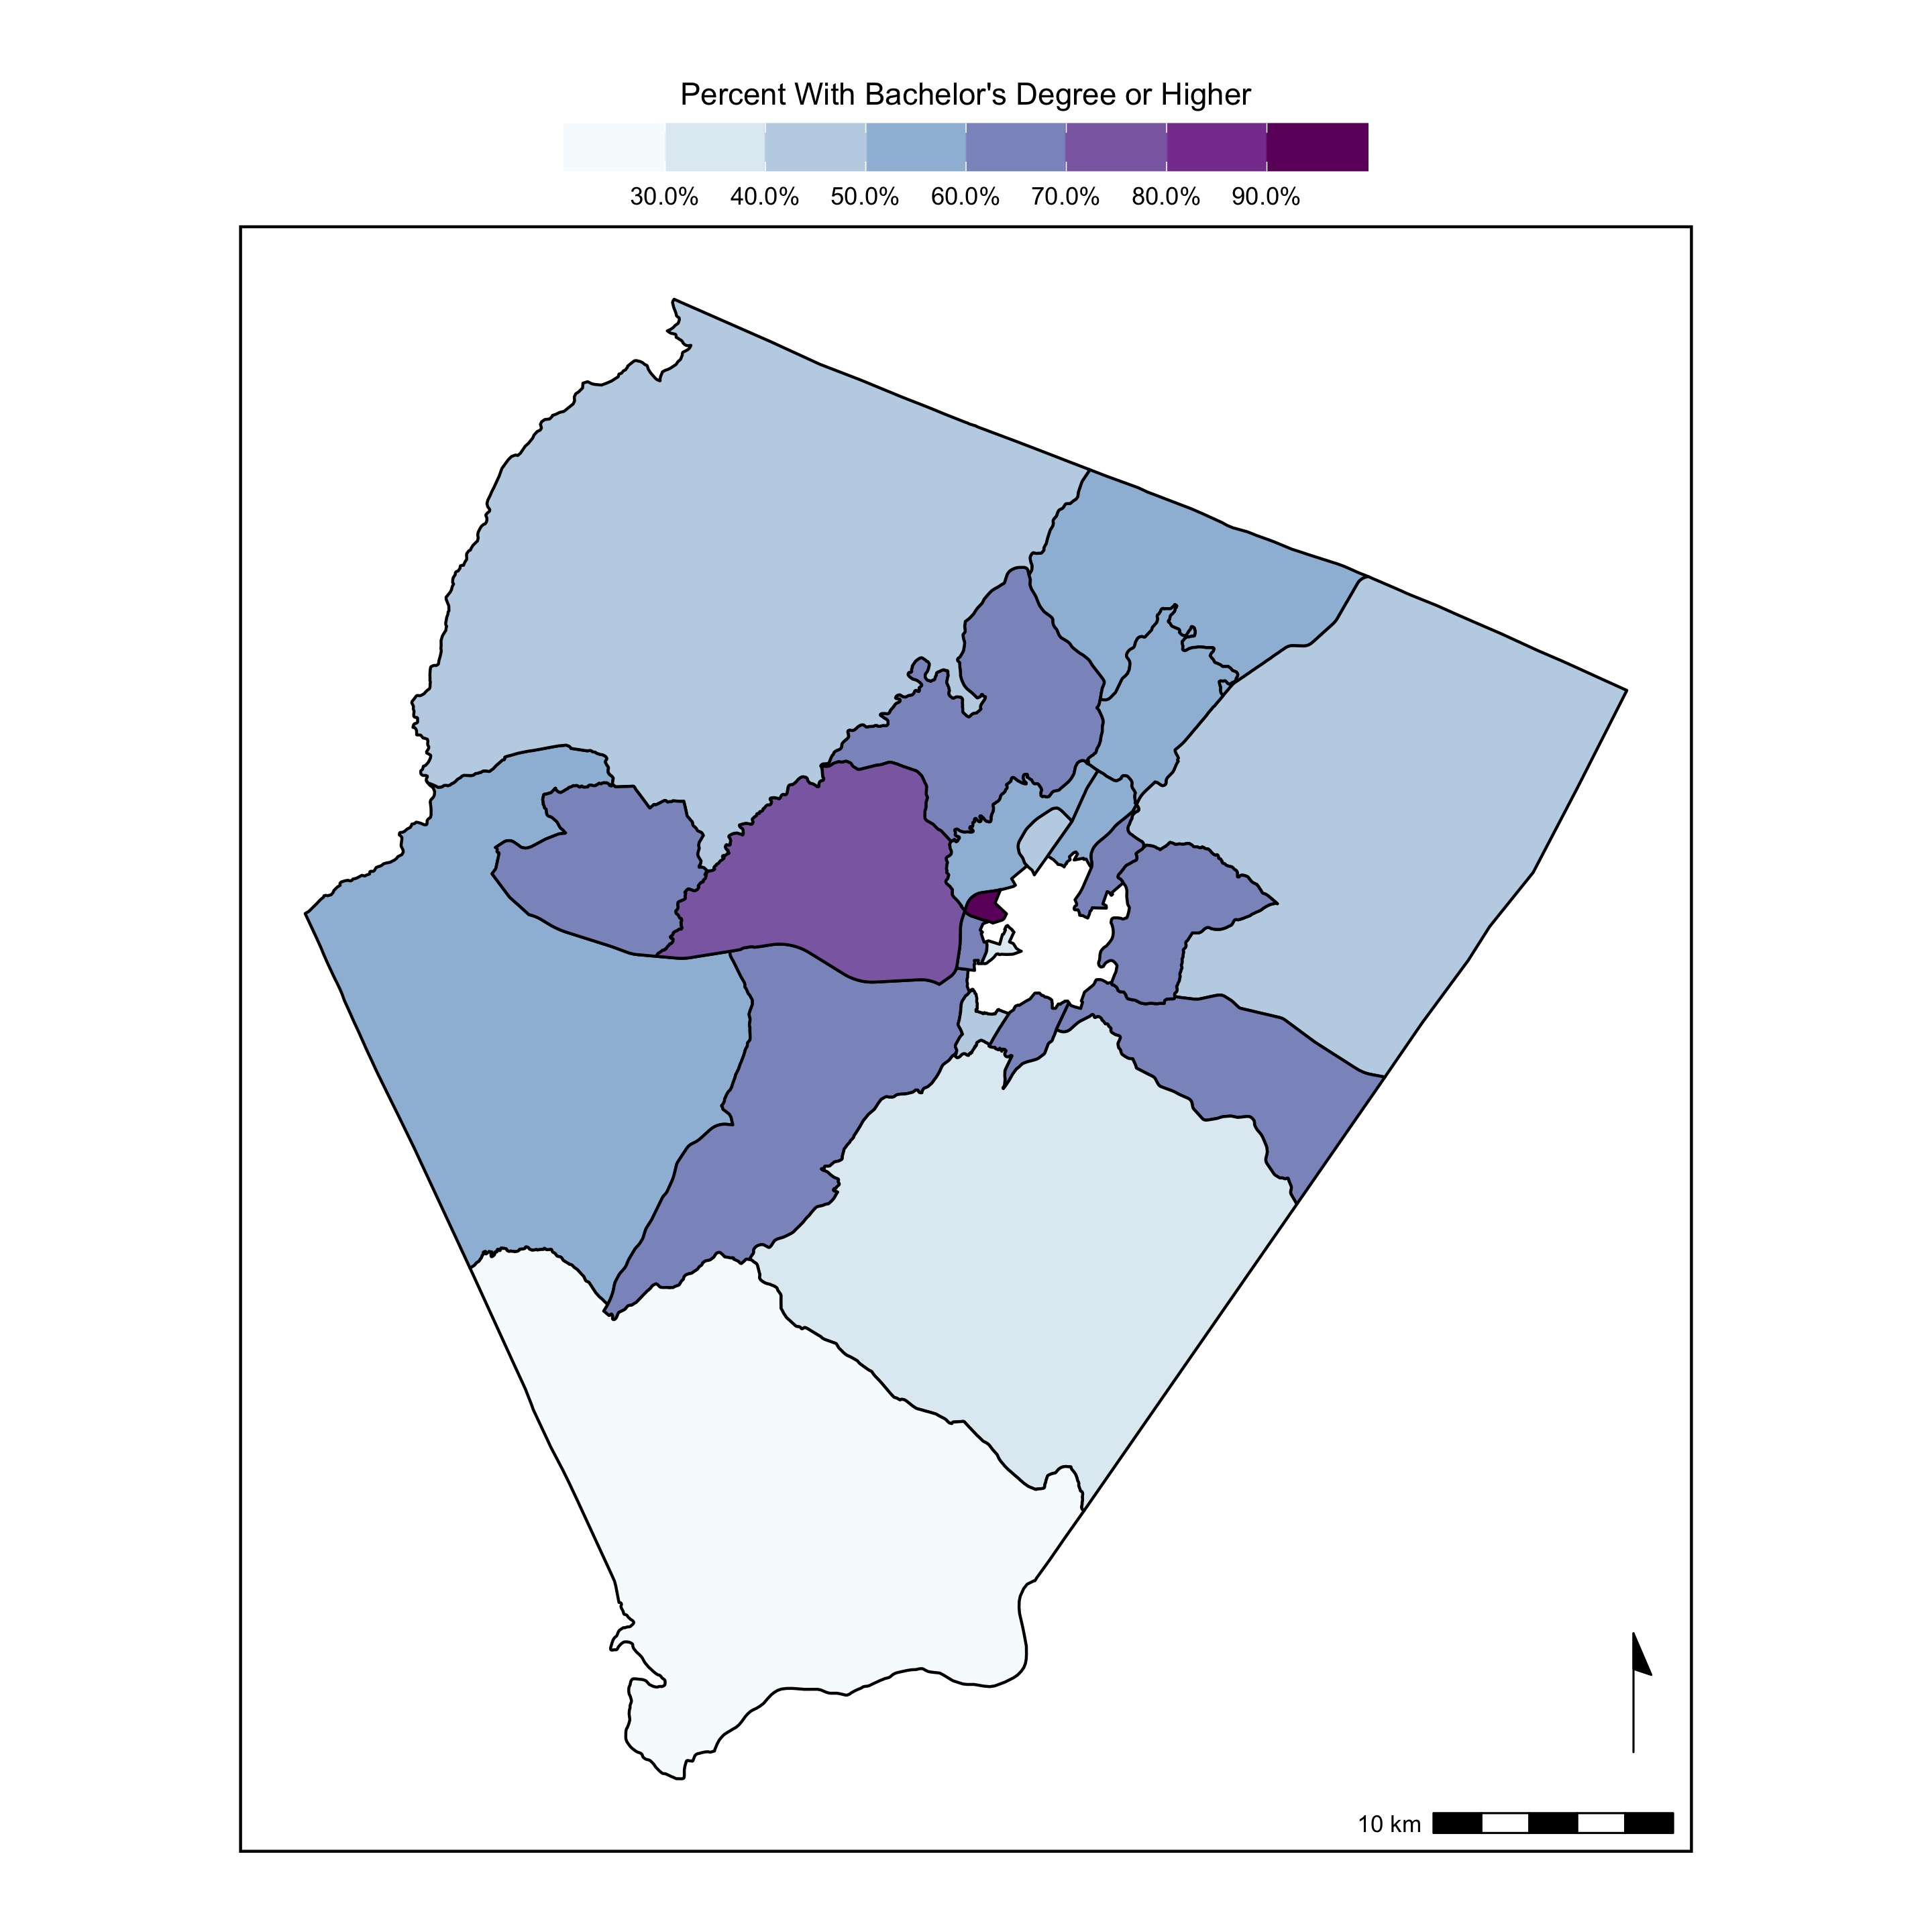
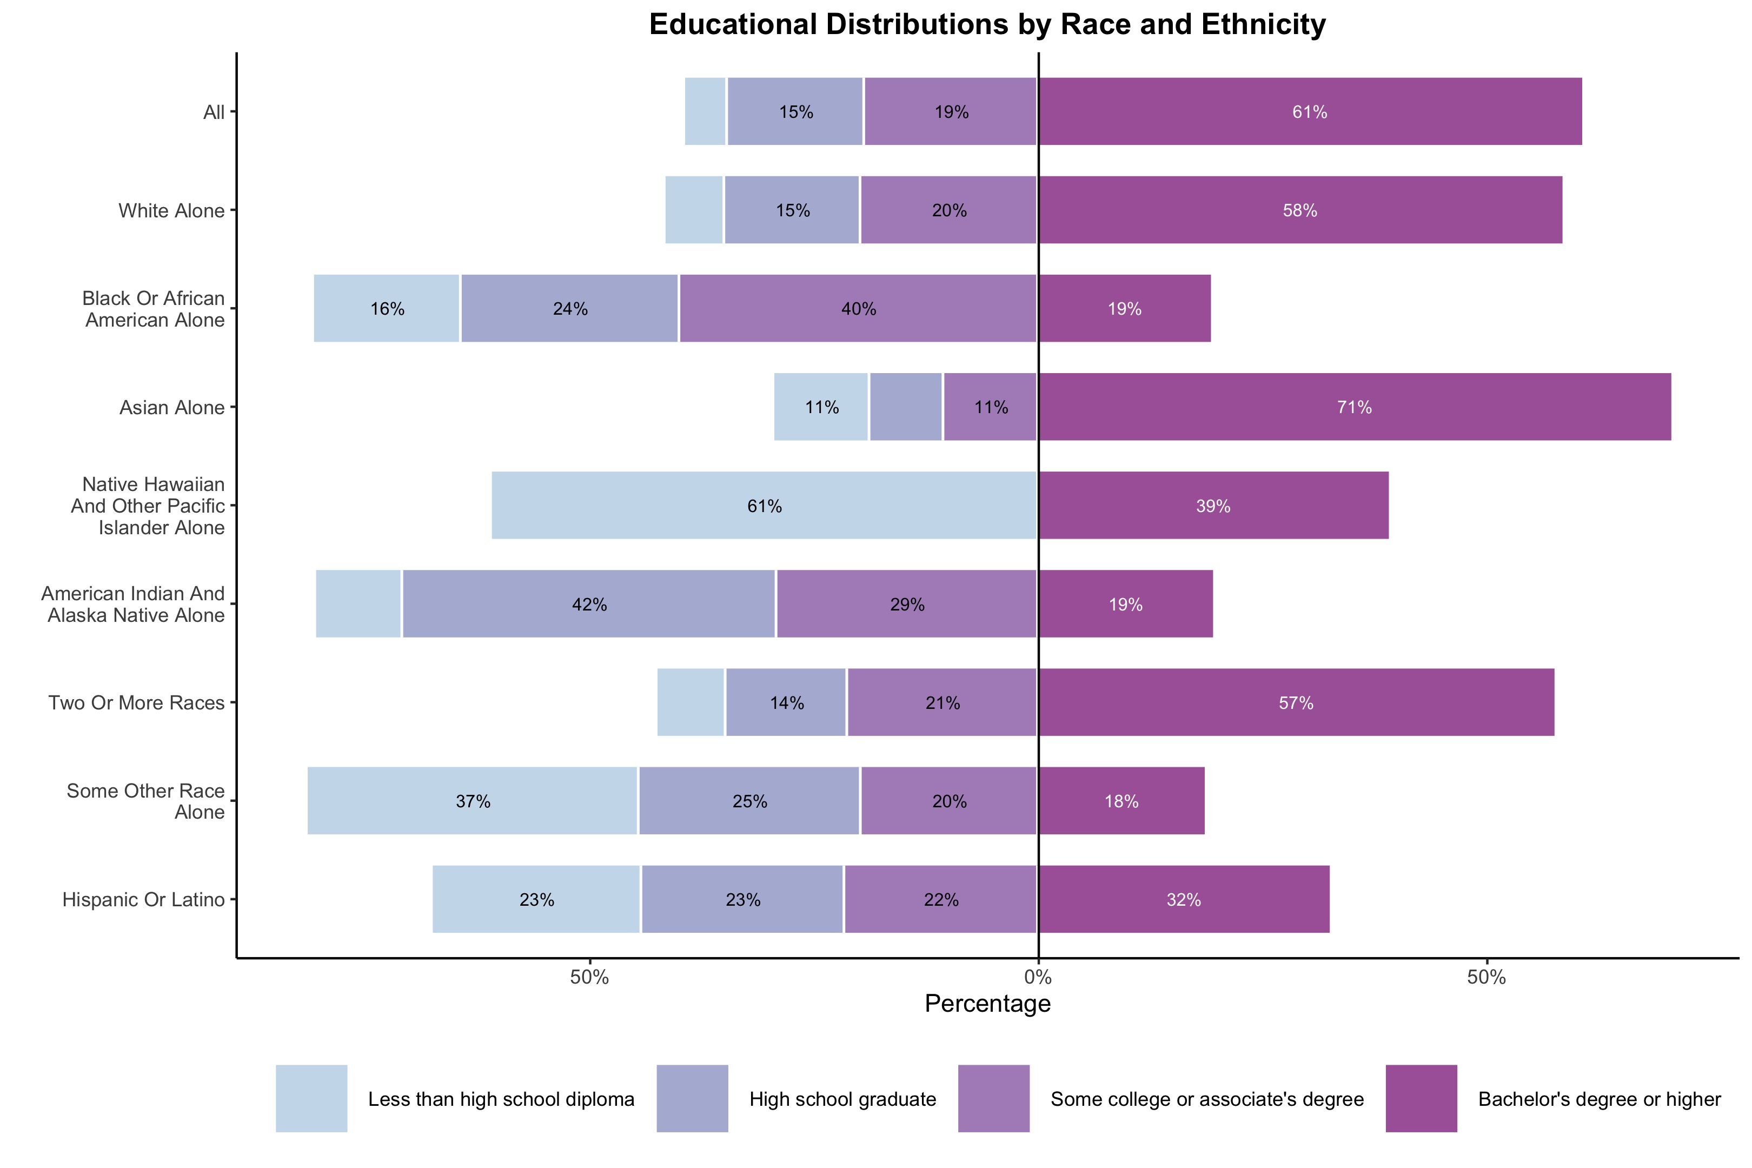
Albemarle County Education Metrics
American HDI
Health
Access to Knowledge
Living Standards

Slide 9
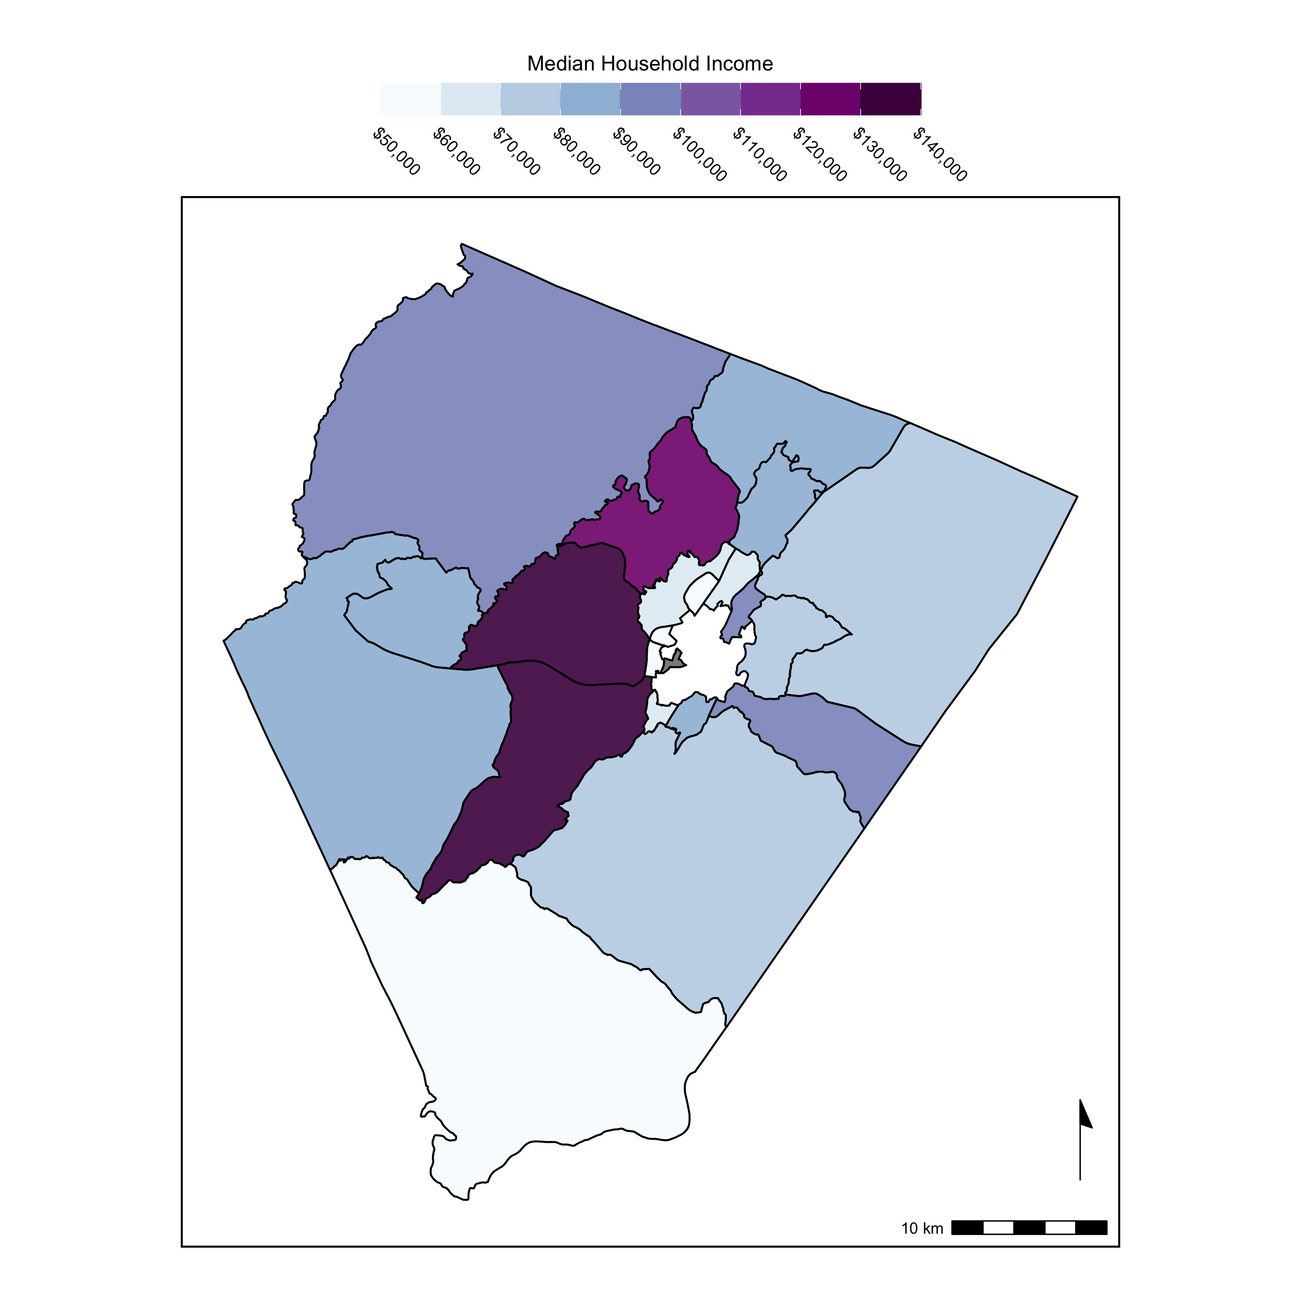
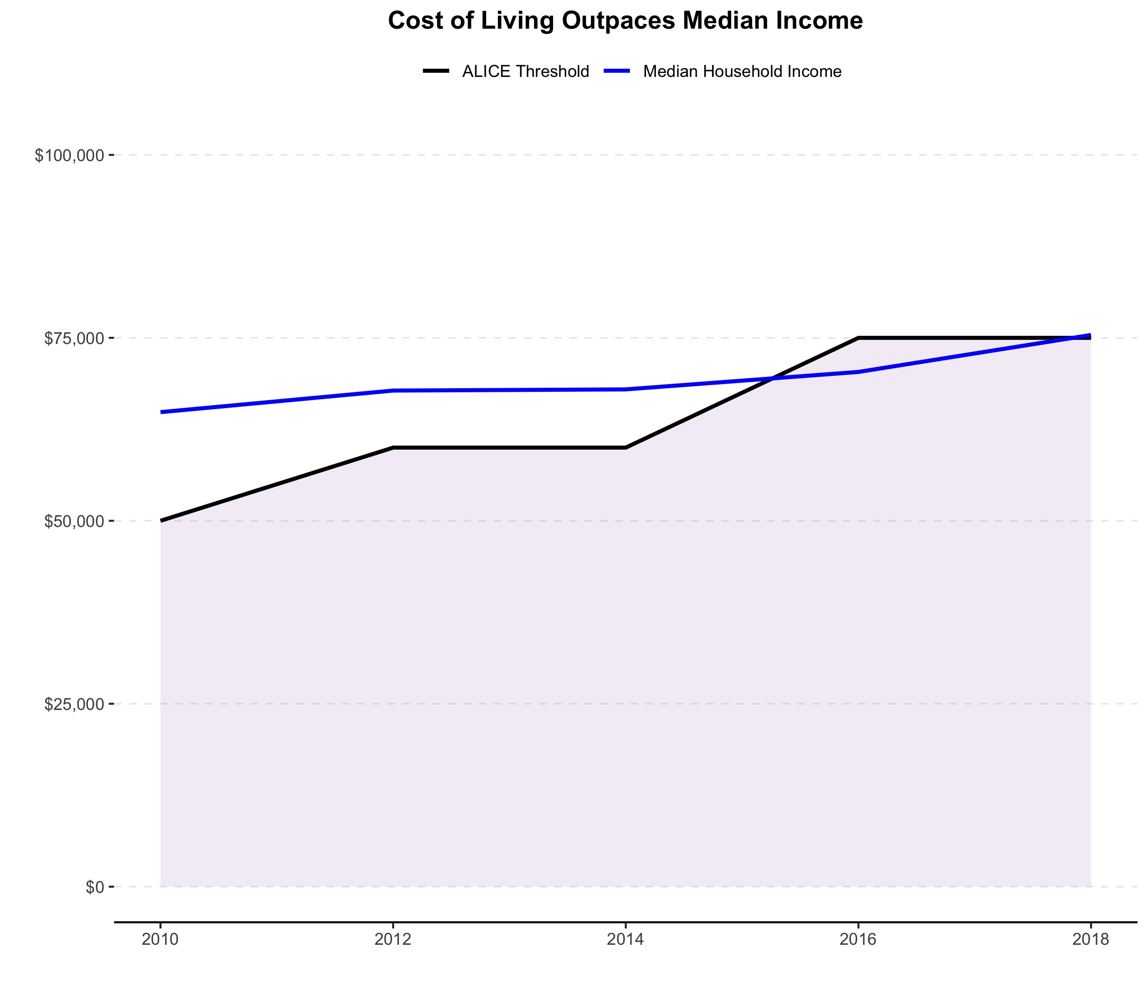
Albemarle County Standard of Living Metrics
Comparison of Asset Limited Income Constrained Employed (ALICE) Threshold and Median Household Income
American HDI
Health
Access to Knowledge
Living Standards

Slide 10
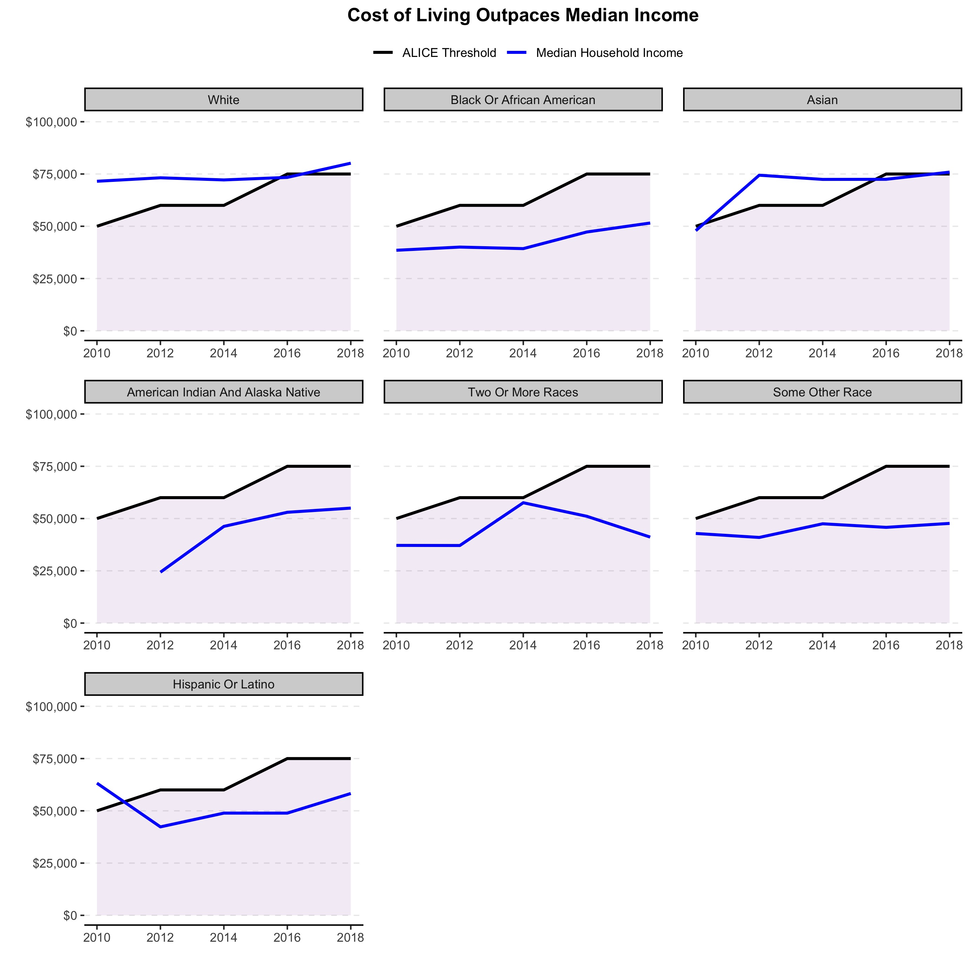
Albemarle County Standard of Living Metrics (by Race and Ethnicity)
Comparison of Asset Limited Income Constrained Employed (ALICE) Threshold and Median Household Income by Race/Ethnicity
American HDI
Health
Access to Knowledge
Living Standards

Slide 11
Any questions?

Slide 12
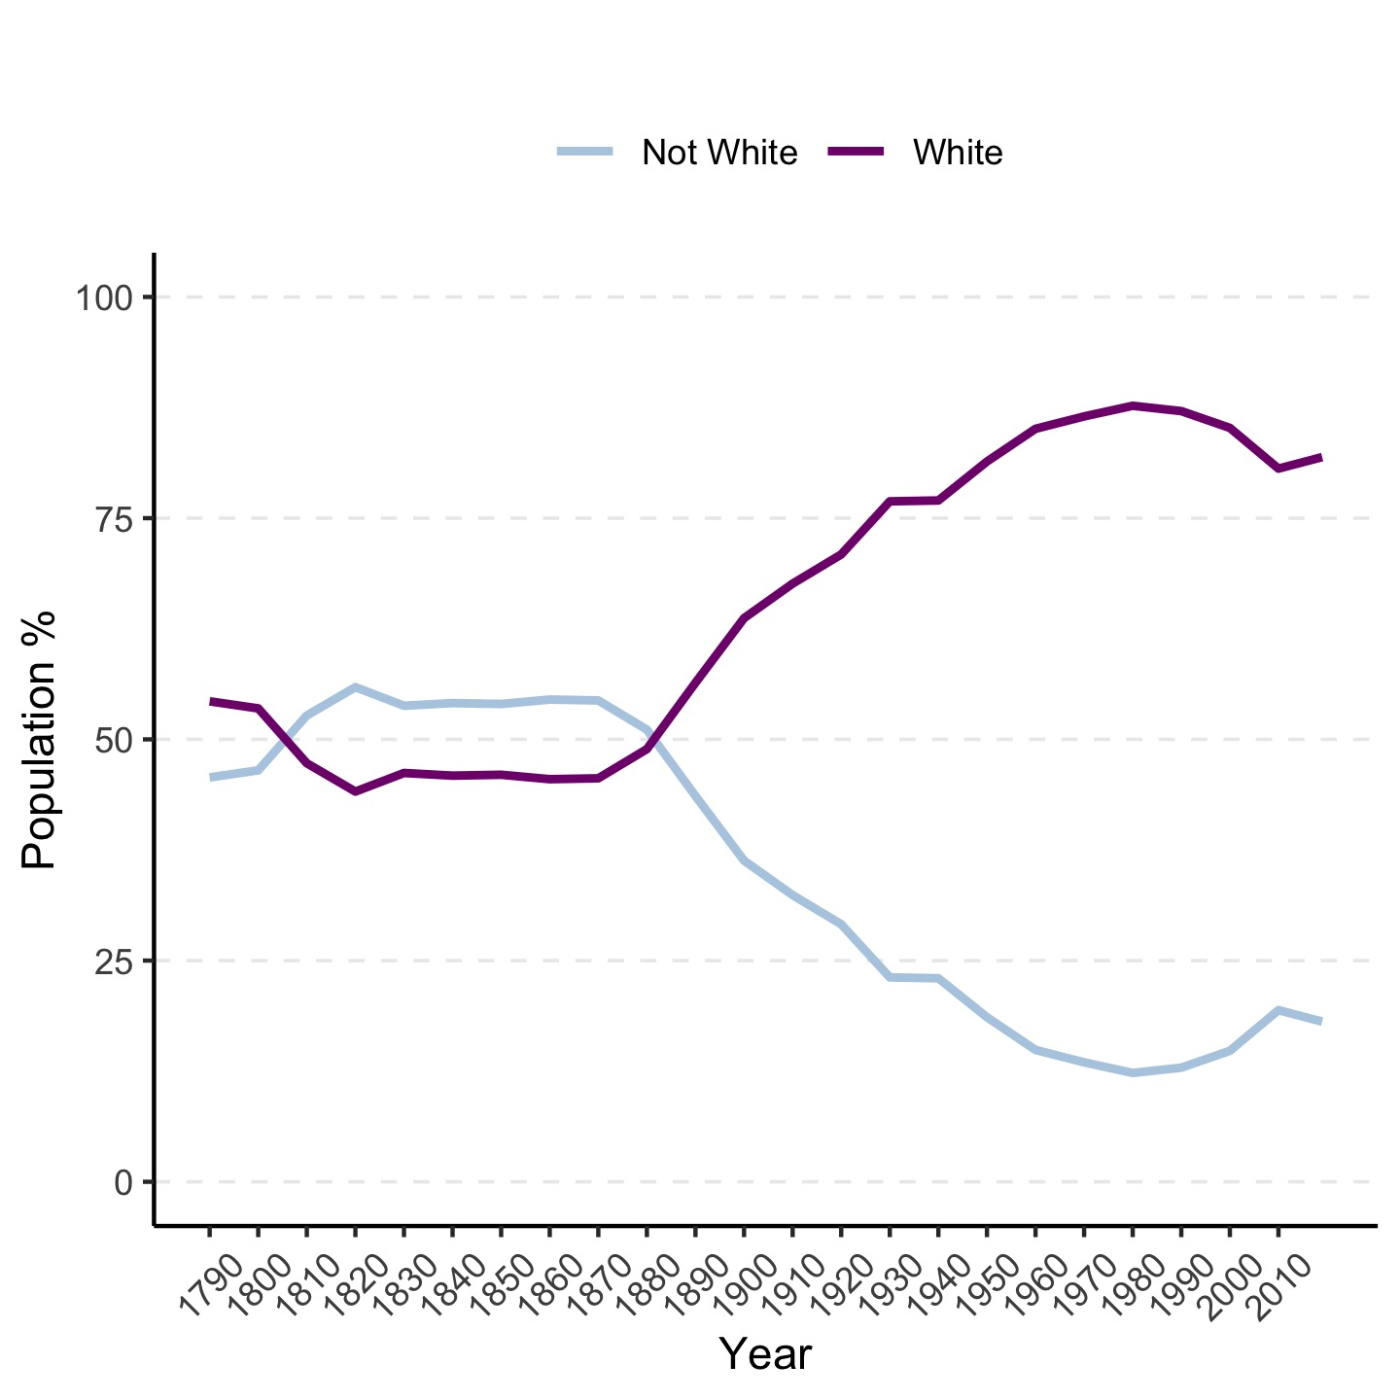
Albemarle County Demographic Trends Over Time

